Slide 1
Comprehensive Audit And Analysis for Effective Digital presence

Slide 2
Company Name: Zoho Corporation Pvt. Ltd.
Founded: 1996
Founder: Sridhar Vembu & Tony Thomas
Headquarters: Chennai, Tamil Nadu, India
Industry: SaaS & Cloud-based Business Solutions
About the Company:
Zoho Corporation is a global software company that offers a wide range of cloud-based business applications. It provides tools for CRM, finance, HR, marketing, and analytics — helping businesses manage everything from one platform.
Task 1: Company Selection and Description

Slide 3
Website URL: www.zoho.com
Purpose: To provide cloud-based business software for CRM, HR, finance, and marketing.
Audit Focus Areas:
Website Design
User Experience
Responsiveness
SEO & Content Metrics
Design Analysis:
Modern, clean, and professional look.
Consistent color scheme (white, red, and blue).
Simple layout with clear navigation menus.
High-quality visuals and icons used to explain tools.
Task 2: Website Audit Report

Slide 4
User Experience:
Fast loading (around 2–3 seconds).
Easy to find products within a few clicks.
Strong CTAs like “Sign Up Free” and “Explore Products”.
Customer reviews and testimonials create trust.
Responsiveness:
Works smoothly on mobile, tablet, and desktop.
Pages adjust perfectly for different screen sizes.
SEO Metrics:
Page Speed: Good
Mobile-Friendly: ✅ Yes
Meta Tags: Optimized with clear title and keywords.
Keywords Used: CRM software, cloud apps, business tools.
Content Quality:
Well-written, simple, and relevant to audience needs.
Highlights product benefits and features clearly.
Blogs and resources help improve engagement and traffic.
Actionable Suggestions:
Maintain keyword optimization for all products.
Add more video content for better engagement.
Improve image compression to load pages faster.

Slide 5
Objective:
Recommend strategies to align Zoho’s traditional and digital marketing goals.
Strategy Highlights:
Focus more on social media engagement through posts, demos, and success stories.
Run targeted ad campaigns on Google and LinkedIn to reach business audiences.
Use influencer or blog collaborations for wider reach.
Personalize email marketing for better customer connection.
Conduct webinars and virtual events to attract potential clients.
Traditional vs Digital Alignment:
Traditional marketing builds brand trust (events, print).
Digital marketing drives measurable leads (SEO, ads, social media).
Combining both enhances Zoho’s global brand presence.
Outcome:
A balanced, integrated strategy to increase brand awareness, engagement, and lead generation.
Task 3:
Digital Marketing Strategy

Slide 6
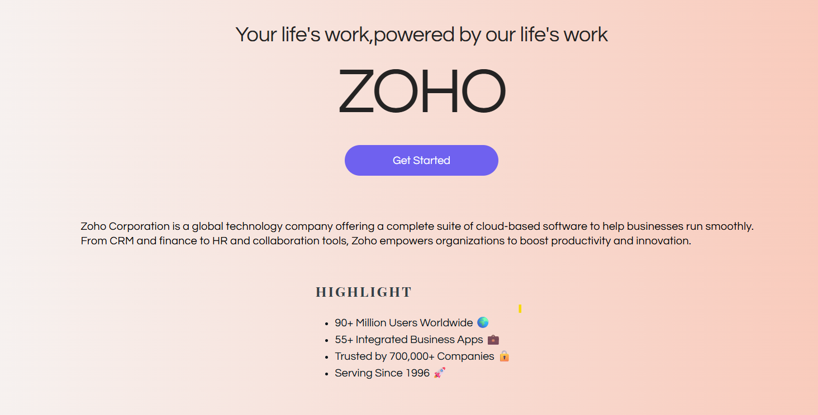
Tool Used: Wix
Website Link: https://dganniejone.wixsite.com/my-site-3
Task 4:
Digital Marketing Strategy

